Slide 1

Office of Aviation Policy and Plans * Office of Aviation Policy and Plans *
Roger Schaufele, Jr
Office of Aviation Policy and Plans
Notes:
Thank you for the introduction, John. I’m delighted that I was invited to speak to you today about our forecast for aviation demand through 2014. Our forecasts of aviation demand are an essential component of the FAA’s planning process. The forecasts of aviation demand are the basis for the forecasts of aviation activity which are used to determine staffing levels and capital expenditures required to accommodate the growth of aviation activity while maintaining a safe, secure, and efficient environment. The forecasts are also used for short-term budget preparation and trust fund analysis as well as cost-benefit and regulatory analyses.

Slide 2

FAA Aviation Forecasts
Fiscal Years 2003-2014
Notes:
Before I go any further, I need to emphasize that the FAA forecast is an unconstrained forecast. We assume that all of the infrastructure will be in place to accommodate the demand we are projecting. So in one sense, I will be presenting an outlook which represents our best guess for the future without constraints.

Slide 3
Topics for Discussion
Review of 2002
Economic Outlook and Industry Assumptions
Aviation Forecasts
Risks to Forecast
Notes:
Today, I’d like to address four topics in my remarks:
First, a quick review of 2002 for aviation.
Second, I’d like to go over our assumptions about the economy and the industry that underpin our forecast.
Third, I want to share with you the actual demand forecasts.
Finally, I want to highlight some of the risks to the forecast that we see.

Slide 4
Review of 2002
Domestic and International Traffic
Air Carrier Finances
General Aviation Activity
Demand for FAA Services
Notes:
In a nutshell, 2002 was a terrible year for aviation.
Traffic fell for second consecutive year;
Domestic RPMs down 6.8% - economy, post 9/11 weak demand
International RPMs down 13.5% - economy, post 9/11 weak demand
Regional RPMs up 21.9% - increased use of RJ’s, route transfers
Cargo RTMs down 4.0% - weak economy
Industry suffered record operating loss in 2002.
Revenues down 16% - Weak demand and yields(loss of business travelers)
Expenses down 11% - Lower ops, lower labor costs, higher cost of fuel
Total operating loss was $10.5B.
General Aviation indicators turned negative.
Shipments and billings down significantly (16.9% and 25.2% respectively for first 3Q of CY2002).
Hours down 5.9% in 2001 - 2nd consecutive year of decline
Demand for FAA services down in 2002:
Tower operations down 2.0% - Air carrier down, GA flat, regionals up
Instrument operations down 2.7% - Air carrier down, GA flat, regionals up
Center activity down 3.3% - Air carrier down, GA and regionals up

Slide 5
Economic Outlook and
Industry Assumptions
Notes:
I’d now like to spend a little time going over our assumptions for the economy and the industry that form the basis for our forecasts of aviation demand.

Slide 6
Economic Outlook
  U.S.
    Modest recovery in 2003, strong growth in 2004/05
    Long run growth in excess of 3%
    Energy prices rise less than inflation
    Inflation remains under control
  World
    Rebound in 03 coinciding with U.S. recovery
    Long run growth averages 3.3%
      Highest growth in Asia and Latin America
Notes:
The economic outlook which the FAA forecast is based on was prepared in December 2002 by OMB. Like many forecasts, the OMB forecast called for a modest growth in 2003 then accelerating growth in the next few years. Real GDP growth in the U.S. for the 12 year period 2002-14 is projected to average 3.0% per year.
Energy prices are forecast to fall in both 2003 and 2004. Thereafter energy prices increase less than inflation for the balance of the forecast.
Inflation remains under control averaging 2.2% per year for the 12 year period 2002-14.
Based on Global Insight’s 4Q 2002 forecast, worldwide GDP growth is forecast to be higher than U.S. growth, with annual growth averaging 3.3% per year during the forecast period. The highest growth rates are found in Latin America and Asia.

Slide 7
Industry Assumptions - FY 2003/04
  Security/Confidence - No more attacks in U.S.; confidence grows
  All major carriers continue to operate => no consolidation
  Capacity
    Domestic up 0.5% in 03, 4.2% in 04
    International up 3.2% in 03, 2.1% in 04
  Load factor improvement greater in 03 than in 04
  Pricing environment
    Domestic - soft in 03, firmer in 04
    International - soft in 03, weaker in 04
Notes:
To understand the FAA’s forecast for aviation demand, we need to spend more time than usual reviewing the assumptions underlying the forecasts. For FY 2003/04 there are a number of assumptions we have made about demand, capacity, industry structure, and pricing. The key assumptions are:
First and foremost is that there are no more terror attacks in the U.S. and that public confidence in flying grows.
No additional major carriers will be forced into a merger or cease to exist due to their financial woes.
Domestic capacity will be up slightly in 2003 before growing over 4% in 2004. In 2003 cuts by the network carriers are offset by the increases in the low cost carriers and regional carriers, while growth in 2004 is spurred mostly by the growth of the low cost carriers. Cutbacks in international capacity will be most pronounced in the 2nd half of 2003 and in early 2004.
Domestic load factor increases sharply in 2003 with the flat domestic capacity then increases modestly in 2004. International load factor increases in 2003 are driven by large y/y increases in the first quarter (Oct-Dec 02).
The domestic pricing environment will be soft in 2003 with weak demand and continued fare sales by the airlines. Pricing in international markets will be soft, though firmer than in domestic markets as the recovery in demand is more pronounced in international markets. In 2004 improving domestic demand helps firm up pricing while in international markets, continued fierce competition restrains the growth in fares.

Slide 8
Industry Assumptions 2005-14
No change in long run relationship between traffic, GDP, and yield
Capacity-Large Carriers
  Domestic ASM growth averages 3.2%
    Seats per aircraft increase to 159
  International ASM growth of 4.9%
    Latin highest at 5.7% , Atlantic lowest at 4.6%
Load Factor
  Domestic up modestly; International peaks then falls slightly
Network carriers successful in reducing unit costs => profitable with lower yield
Notes:
Beyond 2004, the critical assumption underlying the FAA forecast of demand is that the long relationship between traffic, GDP, and yield has not changed as a result of the September 11th attacks.
Domestic capacity growth averages 3.2% with average aircraft size for the large carriers increasing about 1 seat per year, reaching 159 seats by 2014.
International capacity grows faster than domestic, averaging 4.9% per year during this period. The fastest growth is in the Latin markets which are the least mature of all the international markets while the most mature market - the Atlantic, has the slowest capacity growth, only 4.6% per year.
Load factor is assumed to increase both in domestic and international markets. Domestic large carrier load factor rises gradually to 75.5 percent by 2014, while international load factor peaks at 76.8 percent before falling to 76.7 percent by 2014.
Network carriers are successful in reducing their unit costs. (We are deliberately vague about how this occurs – either by Chap 11 or negotiations outside of bankruptcy). This allows the network carriers to be profitable with lower yield.

Slide 9
Aviation Forecasts
Notes:
I now want to discuss the aviation demand forecasts.

Slide 10
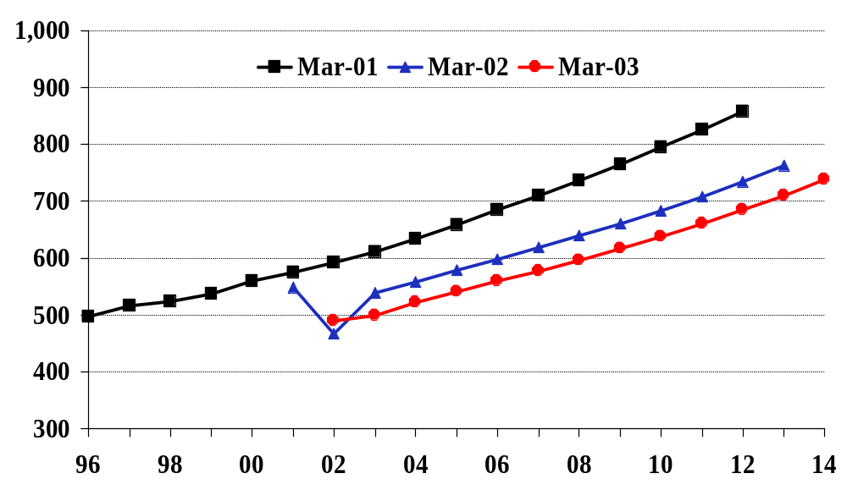
Domestic Large Carrier Enplanements return to pre 9/11 levels in 2006
Millions of Passengers
Notes:
Our forecast of domestic enplanements for mainline carriers is lower than previous forecasts. Instead of a sharp recovery in traffic next year, we are now projecting a modest recovery of only 2.0%. For the 12 year forecast period, average growth in passengers is 3.5% per year which is a full point lower than last year’s forecast for the period between 2002-13. In the current forecast, passengers don’t reach the 2000 level until 2006.

Slide 11
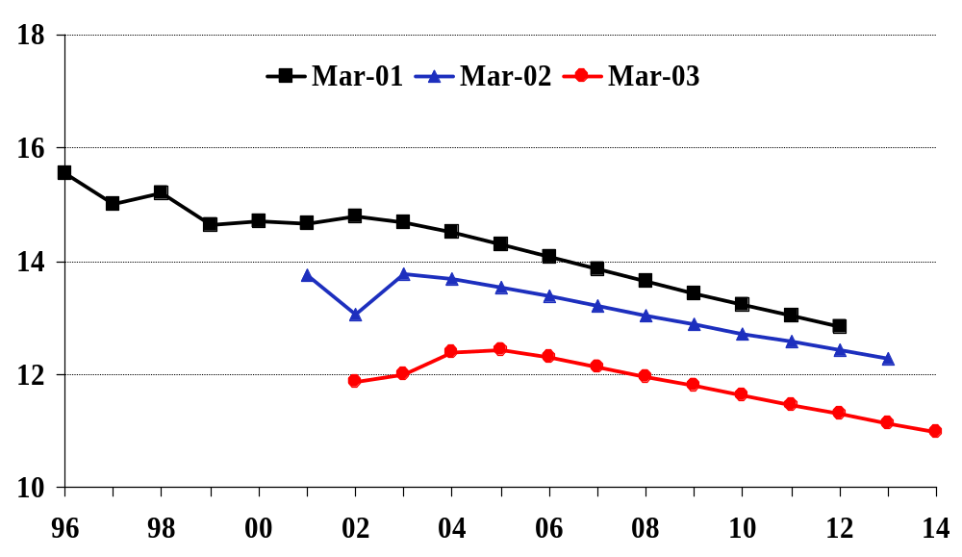
Domestic Real Yield up slightly in
near term then resumes long run decline
Revenue per Passenger Mile (in 2002 cents)
Notes:
The yield forecast is calling for a slight increase in the next couple of years and then a return to a steady decline. During the 12 year forecast period from 2002 through 2014, domestic real yield for mainline US carriers falls an average of 0.6% per year, equal to last year’s decline during the same period. However the level is significantly lower than last year’s forecast due to the significant decline that occurred during the past year.

Slide 12
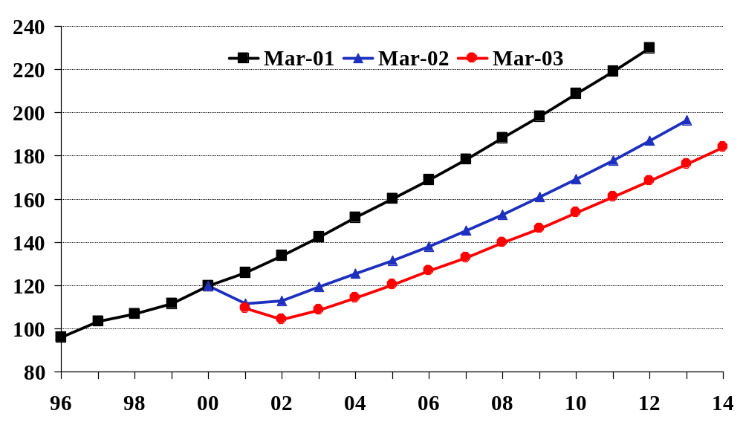
International* Passengers return to
pre 9/11 levels in 2004/05
Millions of Passengers
* Excludes Canada
Notes:
The forecast for international passengers is lower than last year’s. Growth for the 12 year period, 2002-14, is forecast to be 4.9% per year, slightly lower than last year’s 5.2% per year between 2002-13. However, the amount of passengers is lower by almost 9 million in 2002 and increases to 20 million by 2013. Total international passengers don’t reach their 2000 level until 2005, a full 2 years later than last year’s forecast.

Slide 13
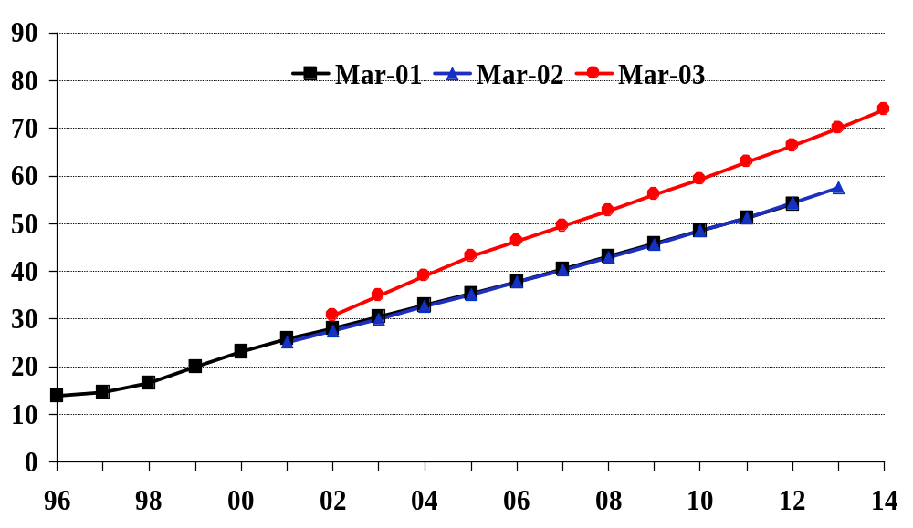
U.S. Regional/Commuter RPMs
continue steady growth
Billions of RPMs
Notes:
The RPM forecast for regional/commuter carriers is significantly higher than previous forecasts. Growth for the 12 year period is projected to average 7.7% per year, up from last year’s 7.1%. Passenger growth (not shown here) is the same as last year’s forecast but the rapid growth in route transfers from the network carriers, plus the continued expansion into new markets utilizing regional jets has increased the trip length forecast significantly propelling the RPM forecast.

Slide 14

Demand for FAA Services
Increases Through 2014
Tower Ops Up 22%
Instrument Ops Up 25%
ARTCC Activity Up 27%
Notes:
Operations at combined FAA and contract towers are projected to increase 1.7% per year over the 12-year forecast period. Commercial aircraft activity is projected to grow 2.5% per year with air carrier activity increasing 2.2% per annum. Commercial operations are forecast to return to pre September 11th levels in 2005.
Instrument operations are forecast to fall slightly (0.4%) in 2003, then increase at a faster rate for the balance of the forecast. The decline in 2003 is driven by reductions in air carrier and general aviation operations. Instrument operations over the forecast period expand 1.9% a year with commercial activity growing 2.5% annually as commuter/air taxi activity increases 2.8% per year.
General aviation instrument operations, which have decreased the past 2 years, are expected to increase 1.4% a year over the forecast period, primarily due to the growth in the fleet of the more sophisticated general aviation aircraft.
Total IFR aircraft handled is forecast to decline 0.3% in 2003 following a 3.3% decline in 2002. Growth resumes in 2004 and continues throughout the remainder of the forecast. During the forecast period IFR aircraft handled increase an average of 2.0% per year.
General aviation aircraft handled at ARTCCs, which increased 1.3% a year during the 90s, is forecast to expand 1.6 % a year through 2014.

Slide 15
Risks to Forecast
Security Issues
International Tensions
Can network carriers cut costs enough?
Return of the business traveler?
Notes:
The risks to this year’s forecast are largely on the negative side.
Security issues constitute the biggest risk to the forecast. While we assume there will be no more terrorist attacks aimed at U.S. aviation, aviation because of its high visibility and global reach will continue to be a target for international terrorism.
International tensions constitute a second risk to our forecast. Our forecast did not assume military action in Iraq. However should war become a reality, we believe there would be immediate significant reductions in both domestic and international traffic, and once the military actions were concluded, sizeable reductions in fares as carriers attempt to woo back travelers. The negative impacts on traffic and fares increase as the duration of the war lengthens.
The ability of the network carriers to sufficiently reduce costs constitutes a third risk. Despite the dismal financial state of the industry, progress by the network carriers towards achieving significant and permanent cost reductions remains spotty. Unless the network carriers make significant cost reductions, the long term financial viability of those carriers will remain in doubt even when demand recovers.
A final risk has to do with the timing and magnitude of the return of the business traveler. We agree with those analysts who believe that business demand may never return to levels seen before September 11th. However the question is whether or not business demand returns to sufficient levels for network carriers to generate sustained profitability (with their lower costs). Obviously the more successful the network carriers are in achieving a lower cost structure, the greater their ability to achieve sustained profitability even with a permanently lower level of demand and revenues.

Slide 16
Forecast Summary
No vigorous recovery in traffic
  Traffic returns to pre 9/11 levels by 2005
Low Fare Carriers increase share => falling fares
Rising Demand for FAA Services
Downside Risks are significant
Notes:
In sum, the FAA forecast calls for a modest recovery in airline traffic with volumes returning to pre September 11th levels by 2005.
Low fare carriers increase their market share in the forecast and this in turn contributes to a continued decline in fares/yields.
As passenger volumes increase, the demand for FAA services rises. Similar to the traffic forecast, growth in Commuter/Air Taxi operations will be highest followed by Air Carrier operations.
Finally, there a number of downside risks to the forecast which, if they were to occur, could result in traffic volumes and activity significantly lower than our forecast.

